Slide 1
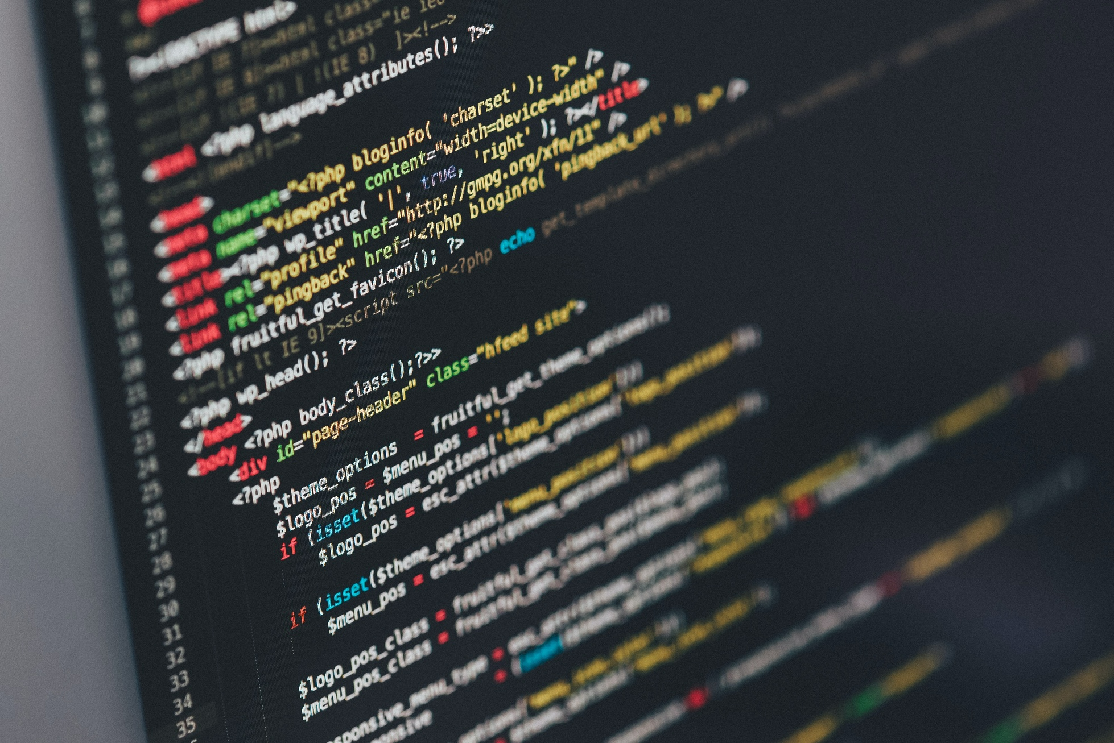

Transitions
Importance of transition words and phrases in academic writing
Creating coherence and smooth flow
Guiding readers through the text
Notes:
Hello everyone! Today, we'll discuss the importance of transition words and phrases in academic writing. These words and phrases make our writing coherent and smooth, guiding readers through the text.

Slide 2
Categories of Transition Words and Phrases
Addition: also, moreover, furthermore, in addition, besides
Contrast: however, on the other hand, in contrast, nevertheless, yet, but
Cause and effect: therefore, as a result, because, since, consequently, thus
Time: meanwhile, after, before, during, subsequently, then
Sequence: first, second, third, next, last, finally
Notes:
Let's look at two examples from computer science. The first one is: "Python is popular for beginners. However, some prefer JavaScript for web development." Here, "however" is a contrast word. In the second example, we have two paragraphs: Paragraph 1: "Python is known for simplicity and readability. Moreover, it has many libraries and frameworks." Paragraph 2: "On the other hand, JavaScript is primarily used for client-side scripting in web development." Here, "on the other hand" is a contrast word that connects ideas across paragraphs.

Slide 3
Examples in Computer Science Context
Example 1: Python is a popular programming language for beginners. However, some programmers prefer using JavaScript for web development.
Example 2: Python is known for its simplicity and readability. Moreover, it has a wide range of libraries and frameworks. On the other hand, JavaScript is primarily used for client-side scripting in web development.
Notes:
We'll cover five main categories of transition words and phrases. Addition words like "also" and "moreover" add information. Contrast words, such as "however" and "but," show differences between ideas. Cause and effect words like "therefore" and "consequently" show reasons or results. Time-related words, including "meanwhile" and "then," help us show when something occurs or the order of events. Sequence words like "first" and "next" help us arrange our ideas in order.

Slide 4
Summary
Effective use of transition words and phrases in computer science writing
Clear, coherent, and well-structured texts
Enhanced reader understanding and engagement
Notes:
To sum up, using transition words and phrases effectively improves our writing. They help create clear, coherent, and well-structured texts, making it easier for readers to understand and follow our ideas. Remember to use these words and phrases to enhance your writing. Thanks for listening!

